Slide 1
IOT AND PLC BASED HOME AUTOMATION SYSTEM WITH PV INVERTER Project guide : Prof. Athira Prasad Project coordinator : Dr. Jinsa Kuruvila
SUBMITTED BY,
MATHEW VARGHESE
AMEER FAYIZ

Slide 2
CONTENTS
Problem definition
Solution
Application/ Socio Economic relevance
Literature survey
Hardware Block diagram
Base station
Receiver node
Pure sinewave inverter
PWM
SPWM
Charge controller
MPPT
Buck converter
Components
NodeMCU
Atmega328
PLC module
FSK
Battery
Solar panel
Result
Advantages
Disadvantages
Challenges faced
Future scope
Reference

Slide 3
PROBLEM DEFINITION
Expensive routers and repeaters required to cover large houses and public areas like bus stands for implementing IOT.
Current IOT systems can be manipulated by hackers due to lack of proper security or tappable Wi-Fi hotspots
IOT systems employ Wi-Fi technology, which cause spectrum crowding in the 2.4GHz free band
Potential health hazards of Wi-Fi in residential areas are yet to be researched
Lack of open source customizable inverter firmwares and designs

Slide 4
SOLUTION
Use powerline for communication
Implement an IOT dashboard so as to control and monitor appliances
Collect usage data so that it can be used to predict the energy usage
Incorporate solar panel to this system so that users can generate electricity
Create a github repository and allow changes to the design by various individuals

Slide 5
APPLICATIONS/ SOCIO ECONOMIC RELEVANCE
Decentralized energy production encourages the use of green energy
Less dependency on centralized power generation
Can be used as standalone system in hard to reach areas
Optimize power usage by predictive analysis and automation
Control and monitor the status of devices via internet or mobile application
Provide analytics on the energy usage pattern of households.
Open source IOT based smart PV inverter system encourages further development in this area

Slide 6
LITERATURE SURVEY
Paper 1:
Rayyan Farzan and Zareena gave valuable insights about the PLC section and we coded the PLC microcontroller based on it.
Paper 2:
Salman and Xin Al explained the working of Perturb & Observe algorithm of MPPT

Slide 7
Paper 3:
Kirti P shinde proposed a topology for interfacing PLC systems with IOT dashboard
Paper 4:
Paper by Ravi and Jain helped us to design the IOT system and connect it to online services

Slide 8
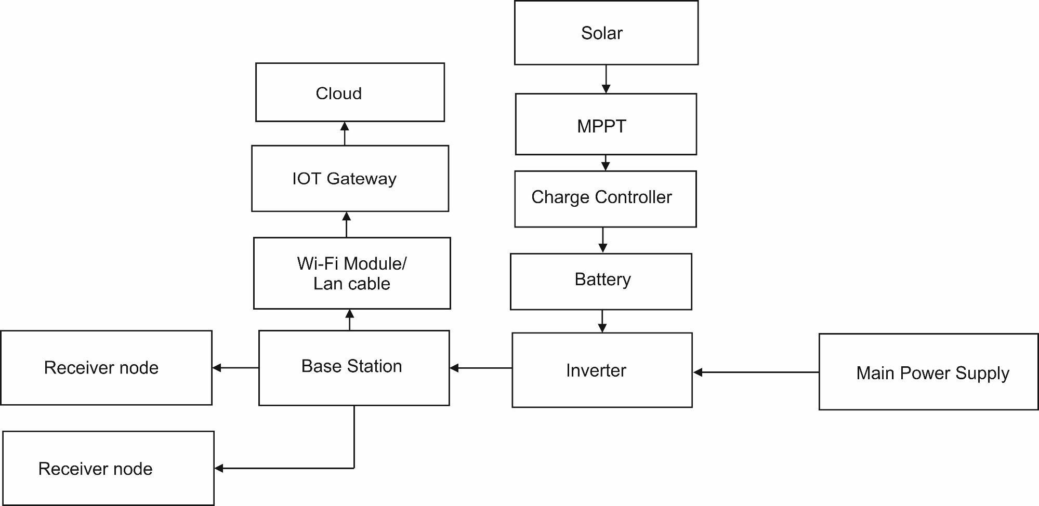
HARDWARE BLOCK DIAGRAM

Slide 9
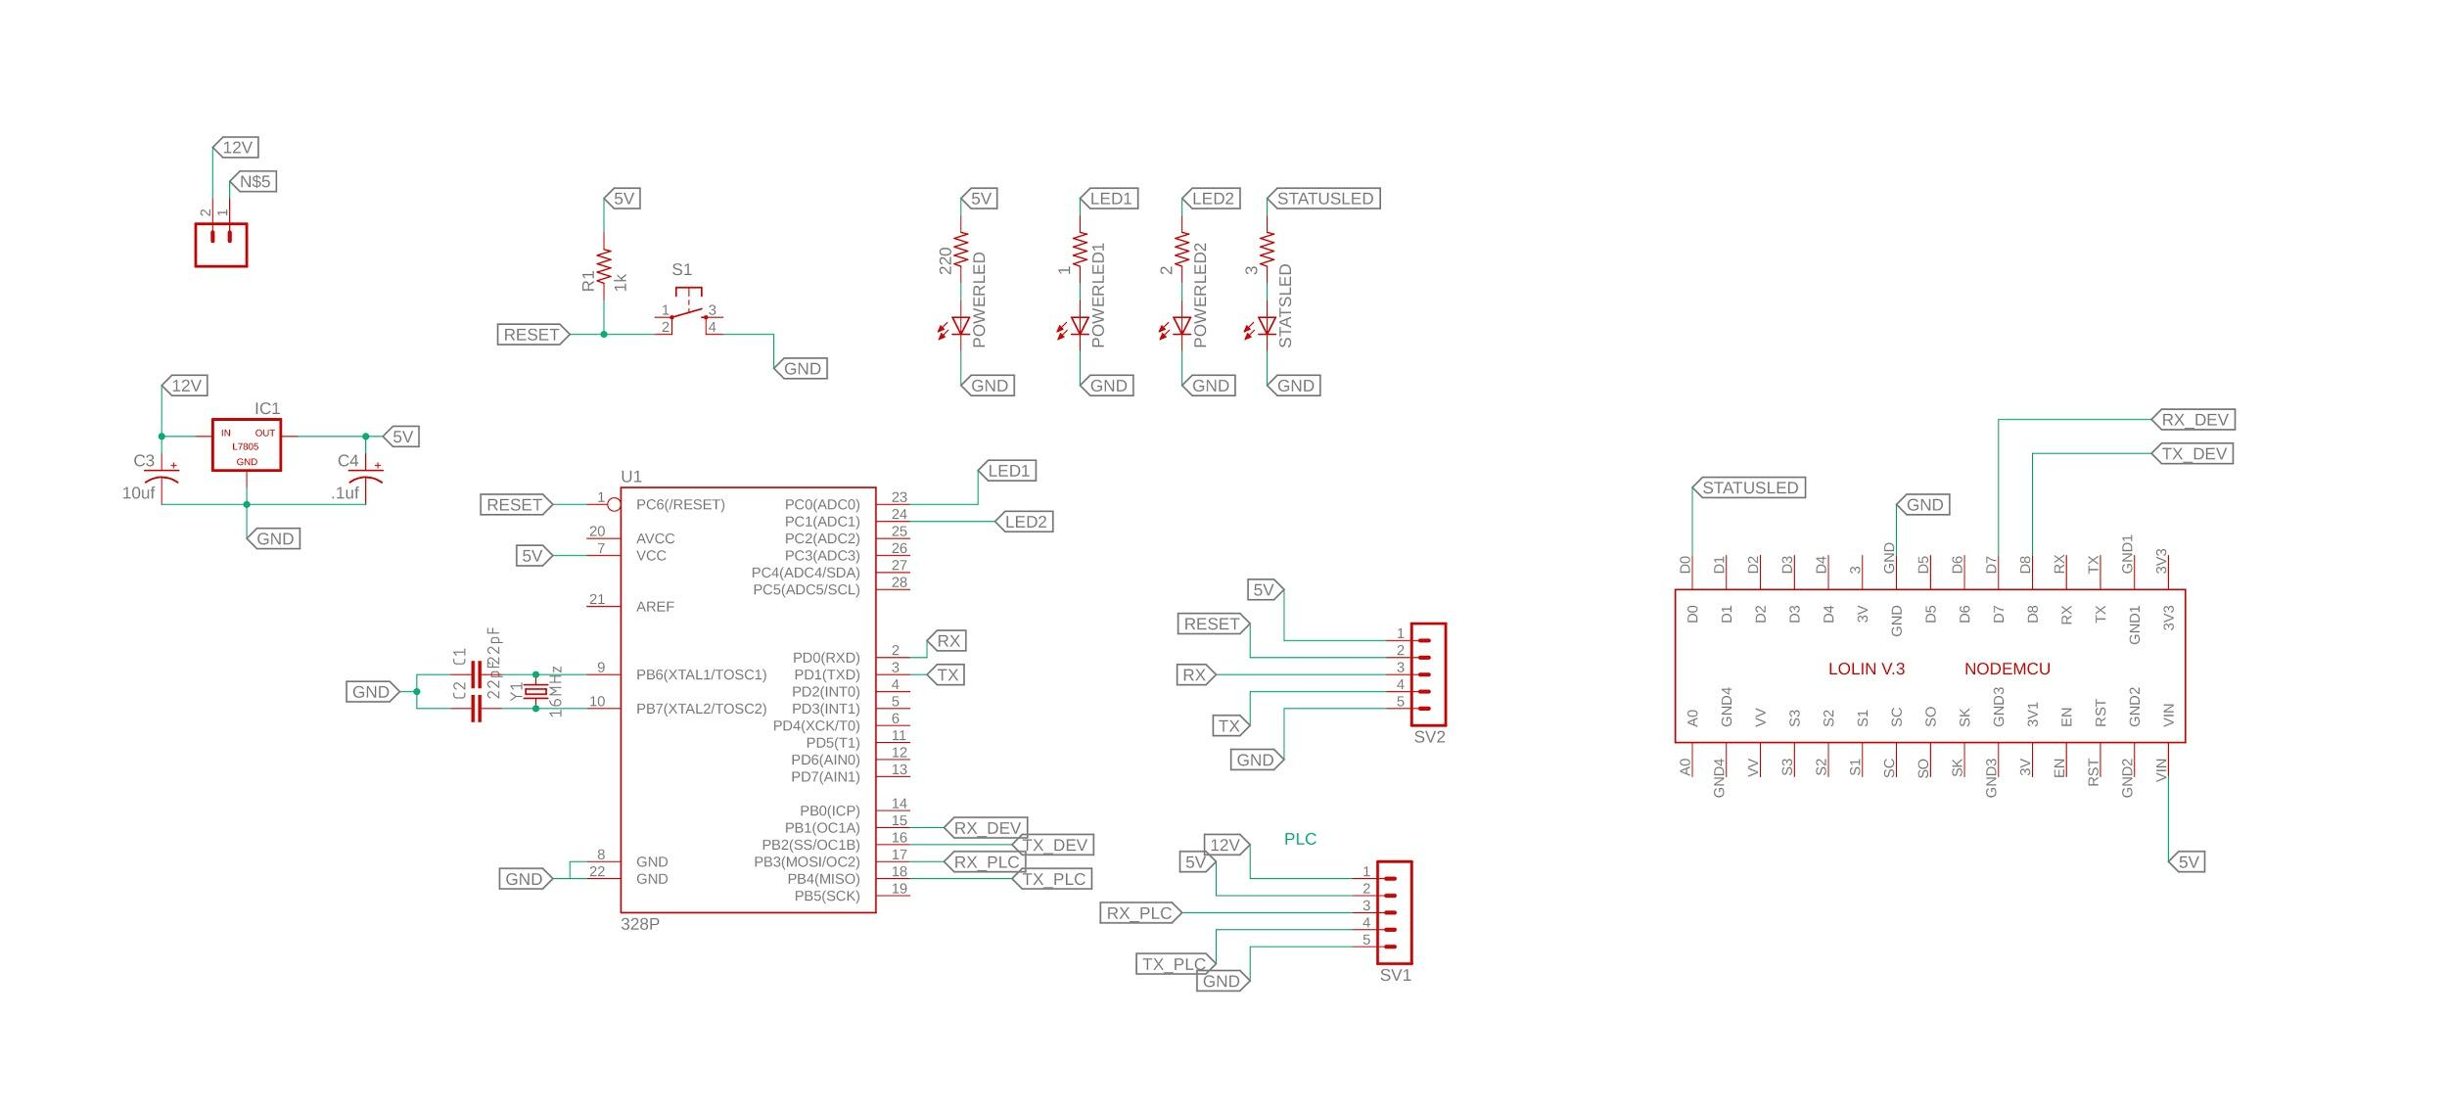
Base station

Slide 10
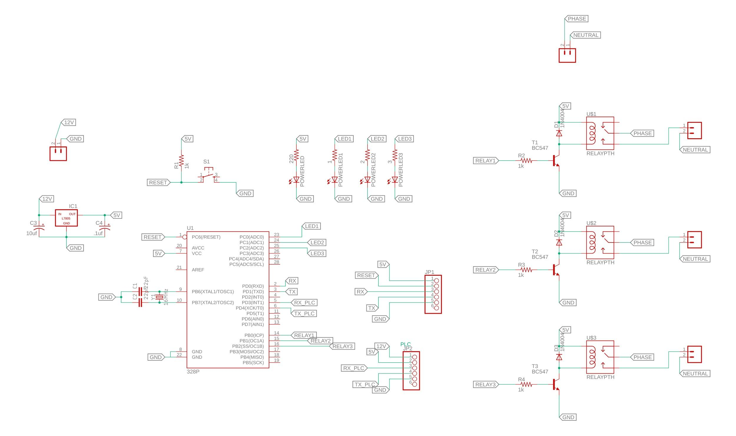
Receiver node

Slide 11
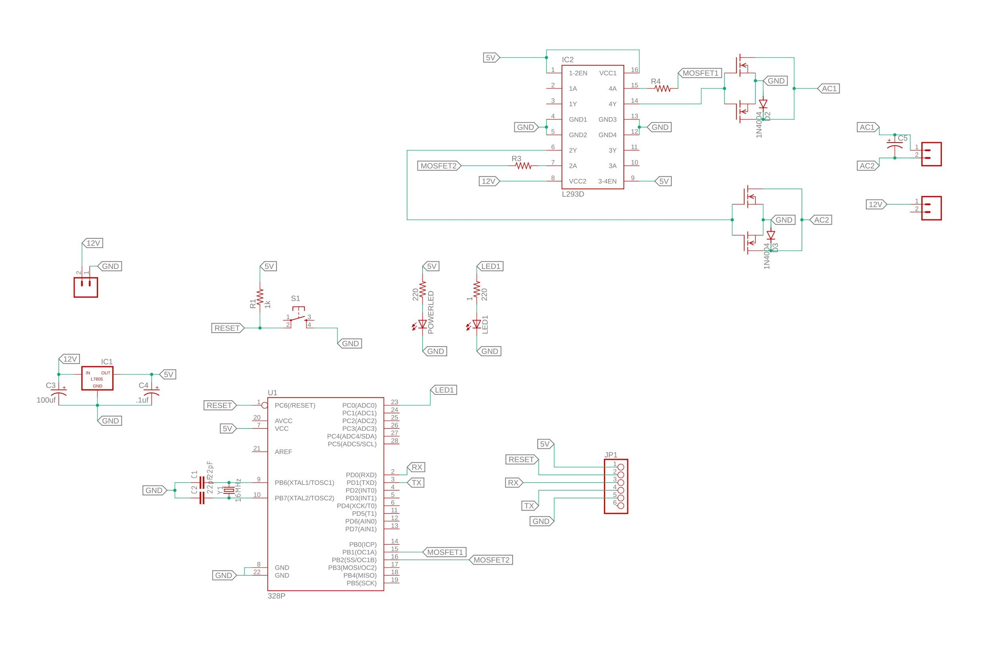
Pure sine wave Inverter

Slide 12
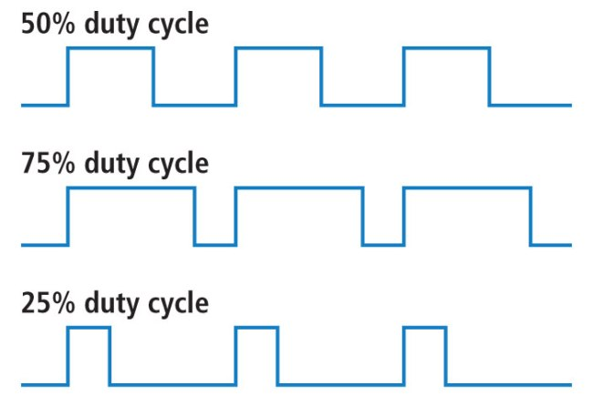
PWM

Slide 13
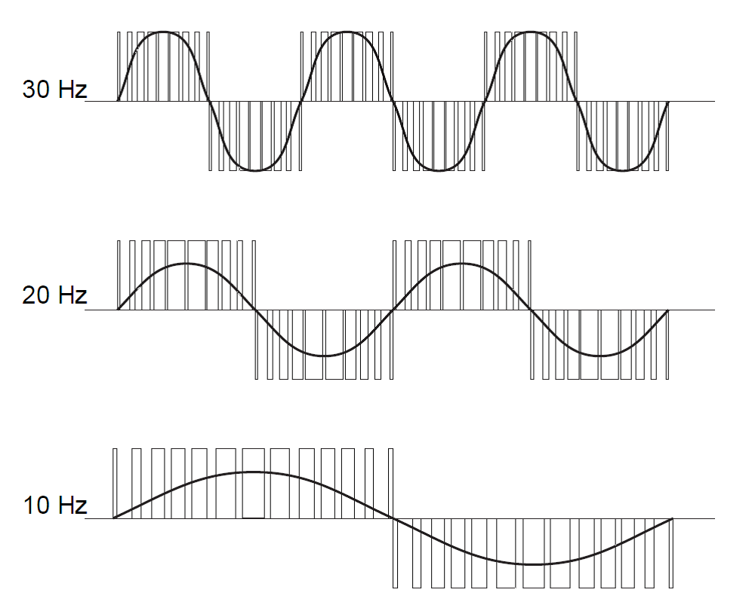
SPWM

Slide 14
Atmega328 PWM frequency
Max attainable frequency for Atmega 328p at 16 MHz clock: 62.5 KHz
490 Hz for arduino

Slide 15
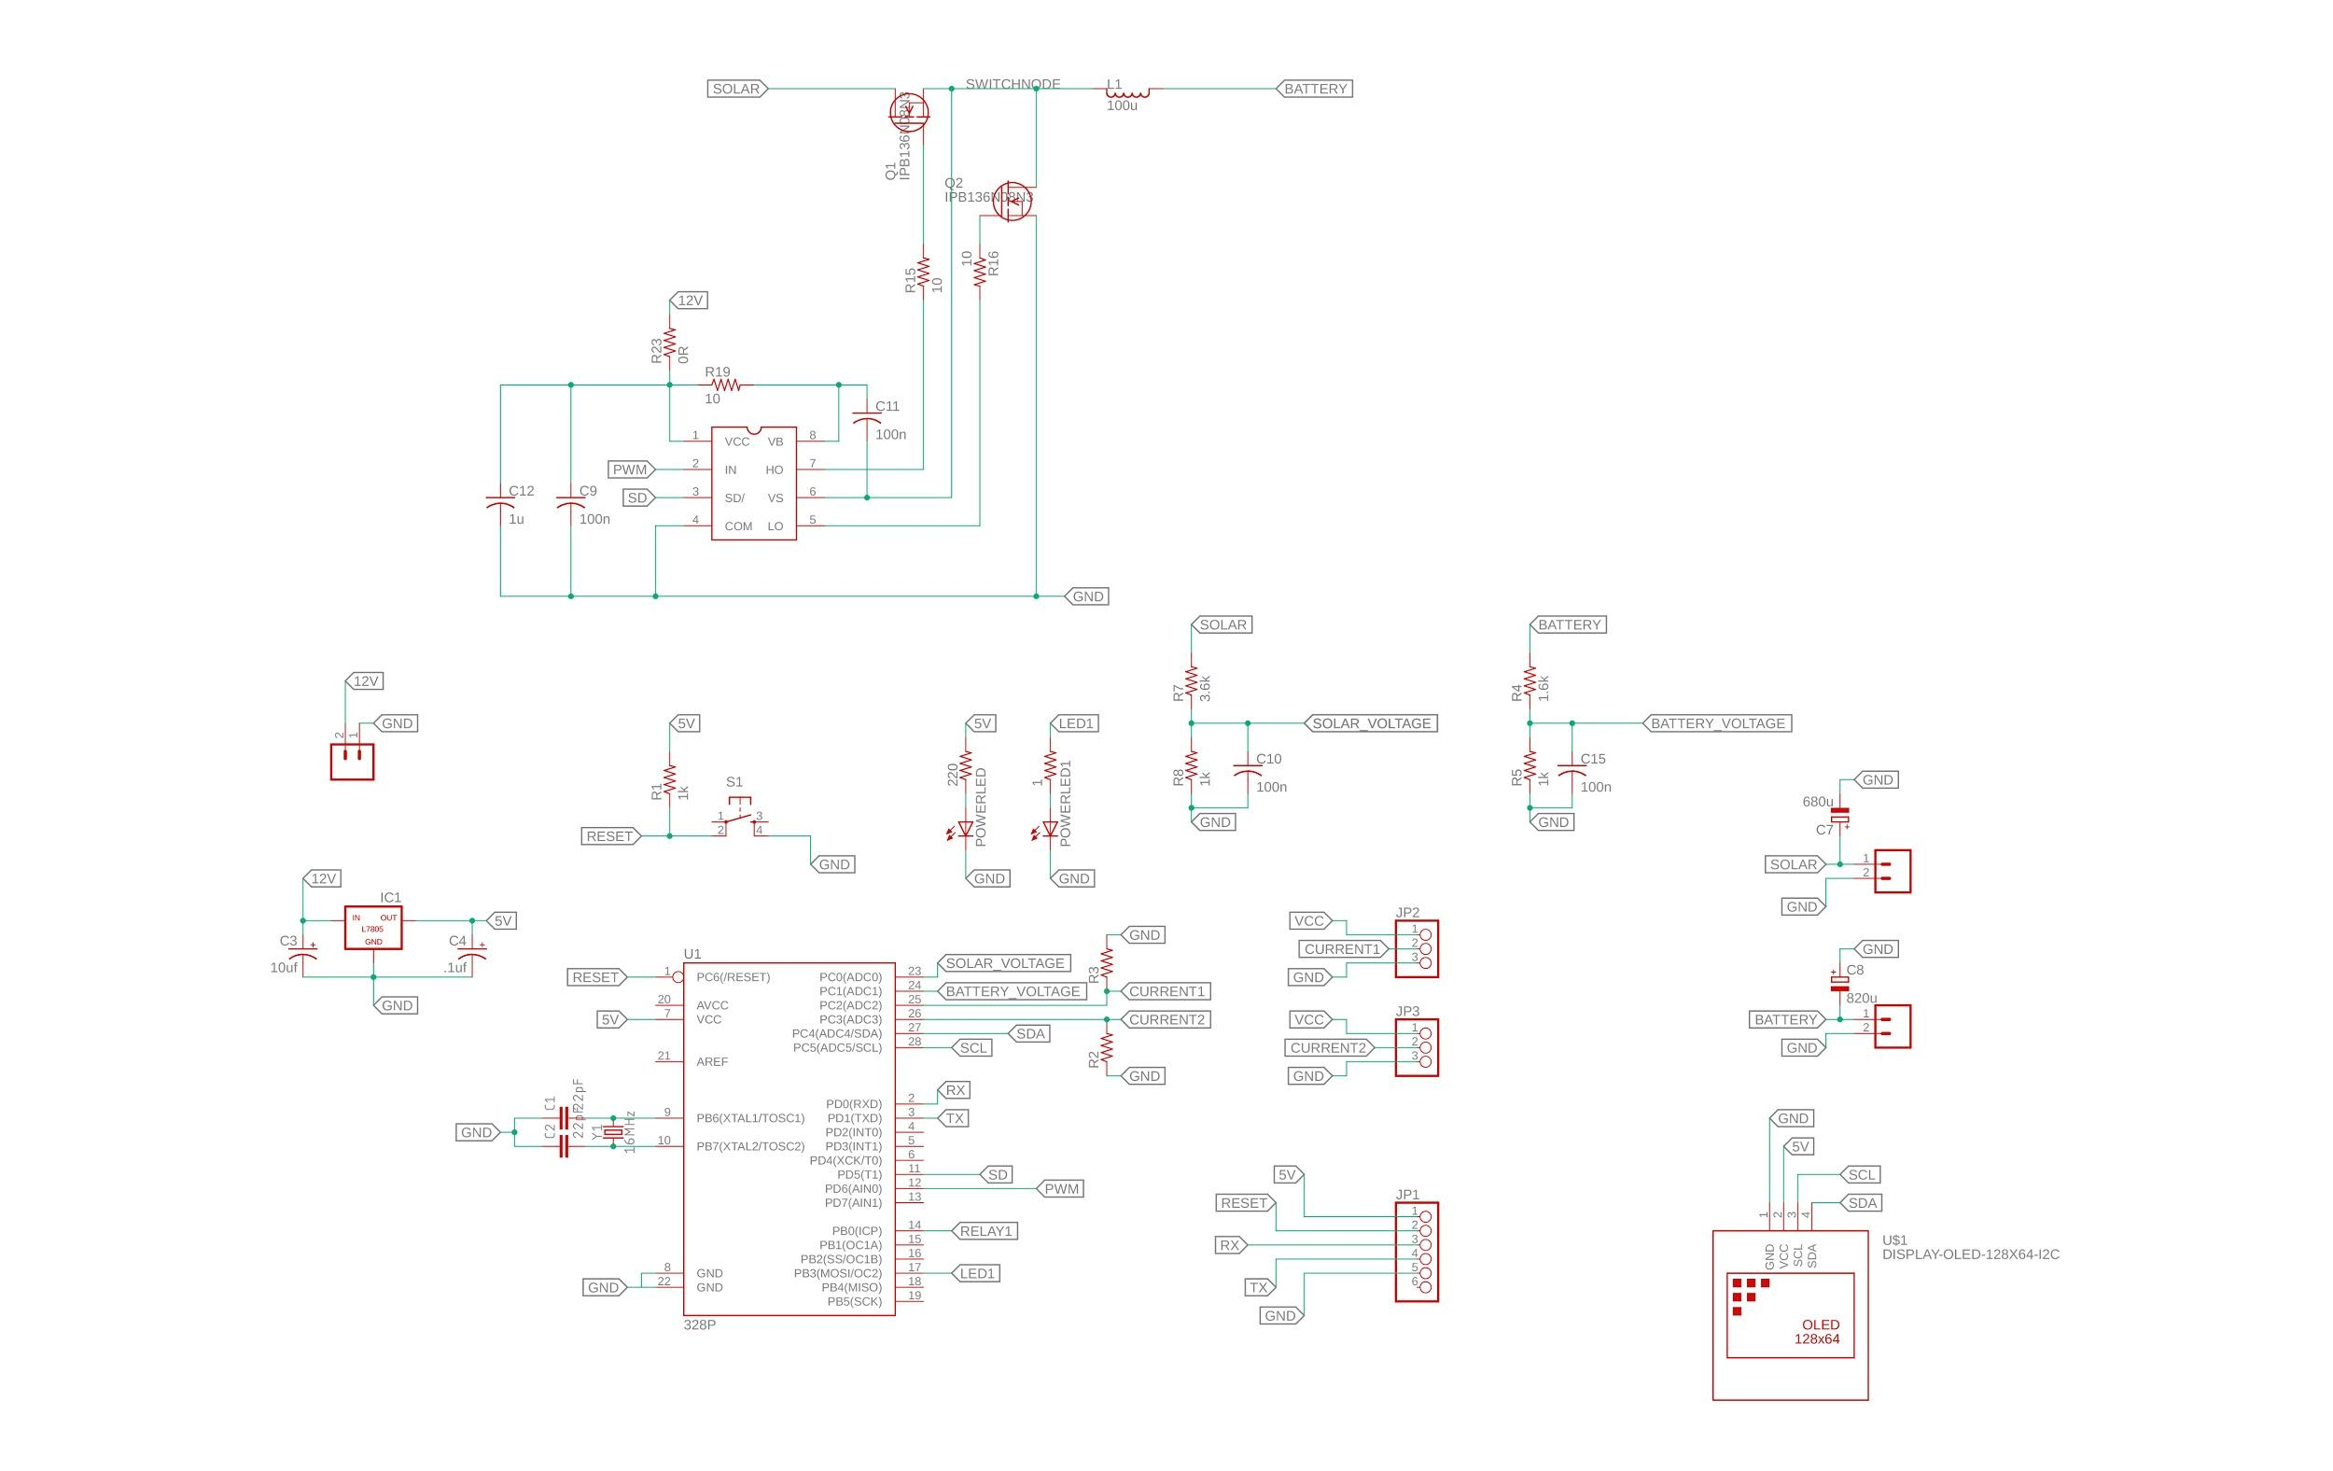
Charge Controller

Slide 16
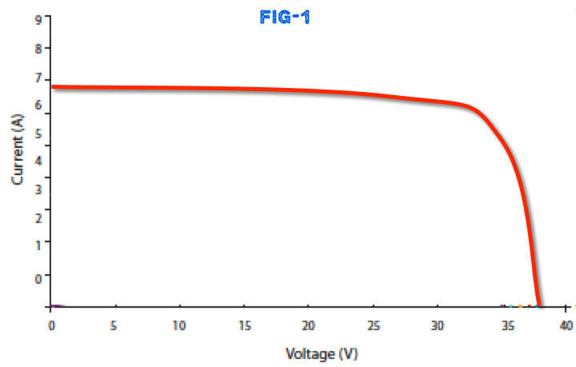
Factors 1.The amount of sun light 2.The connected load 3.The temperature of the solar panel.
MPPT

Slide 17
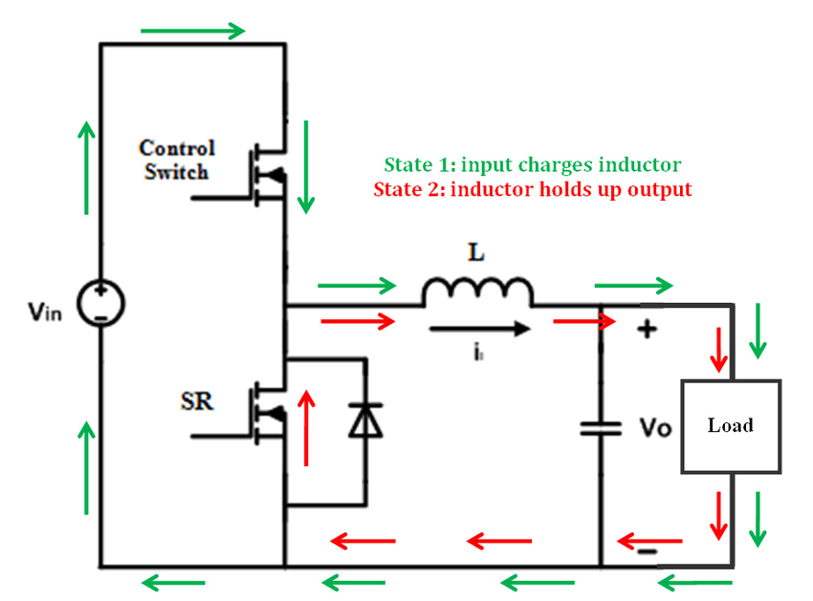
Buck converter

Slide 18
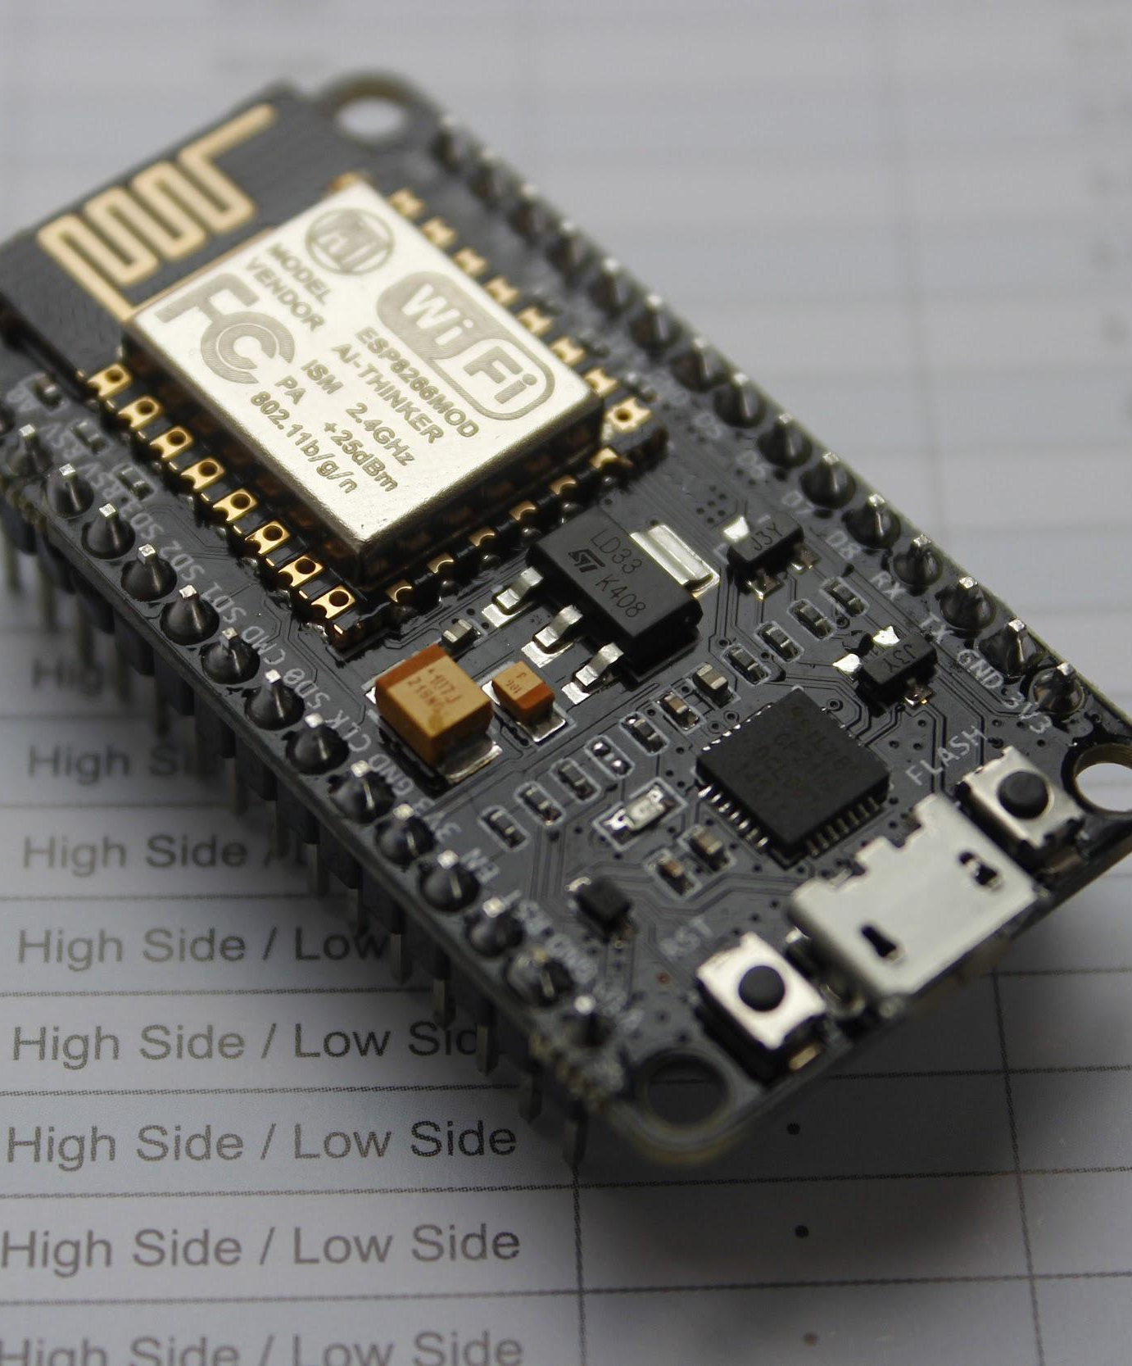

COMPONENTS: NodeMCU
Open source IOT Platform.
Includes ESP 8266 Wifi SoC.
Has analog and digital pins
Supports UART,SPI, $I^{2}C$
Operates at 3.3V.

Slide 19
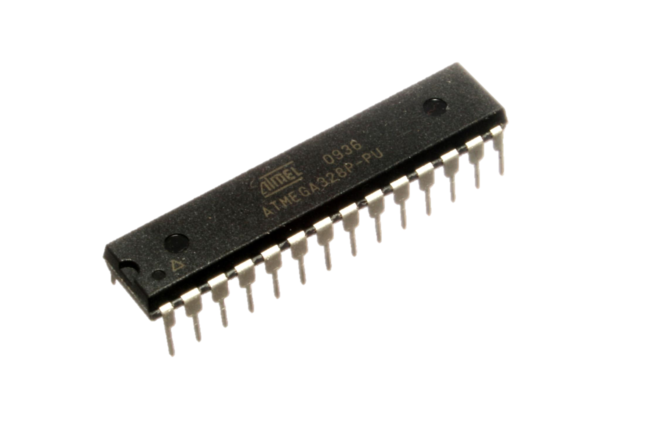
Atmega 328p
28 pin
23 GPIO
SPI, I2C, UART
5v supply
16 MHz clock
32 KB memory
2 KB ram

Slide 20
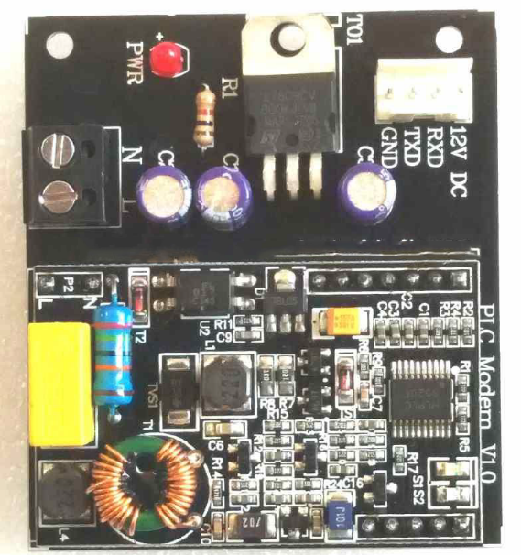
PLC1672
Default Baudrate of 9600.
Communication in half duplex mode.
Working environment: 230V 50/60Hz
Communication distance: 150m
Power line carrier frequency: 72kHz
Modulation and demodulation mode: FSK

Slide 21
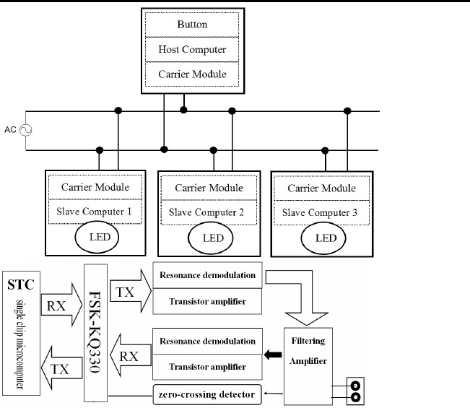
PLC Block diagram

Slide 22
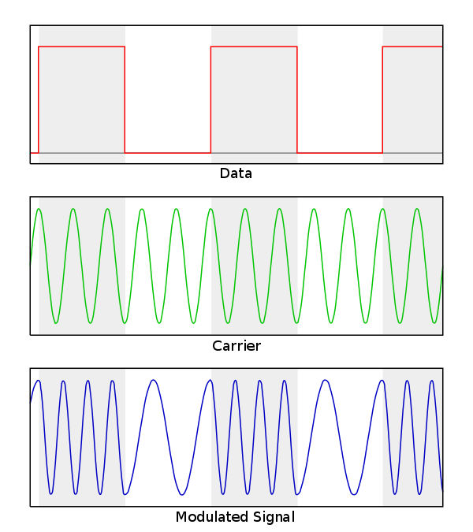
Frequency Shift Keying(FSK)

Slide 23
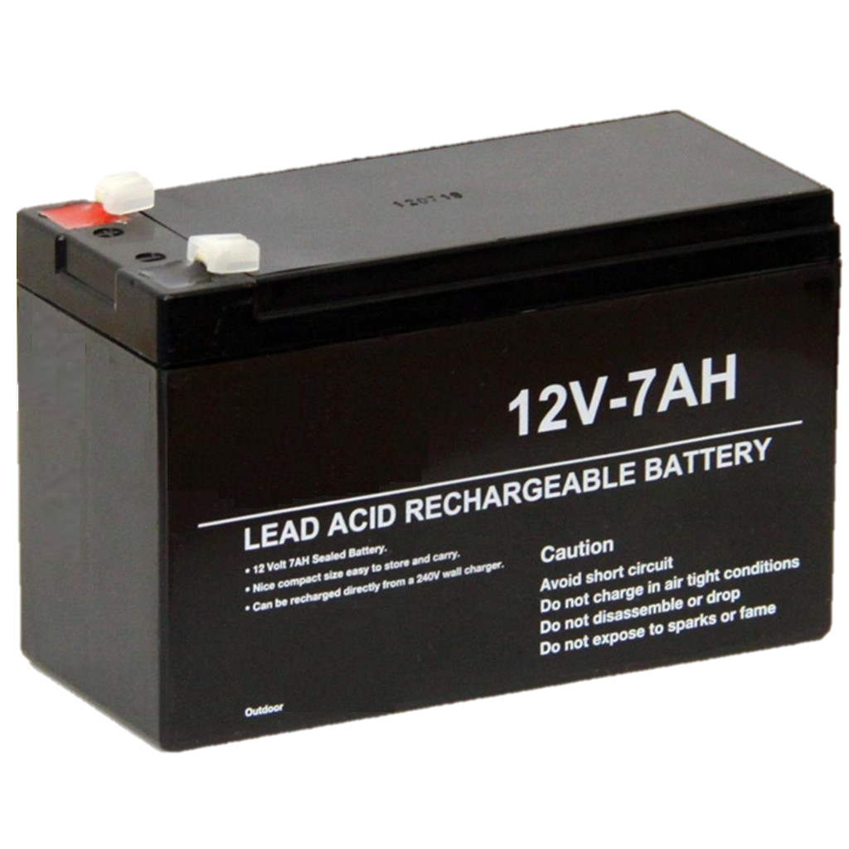
Lead acid battery
7Ah 12V
Max voltage 14.5v
11v-12.6v
1c charging

Slide 24
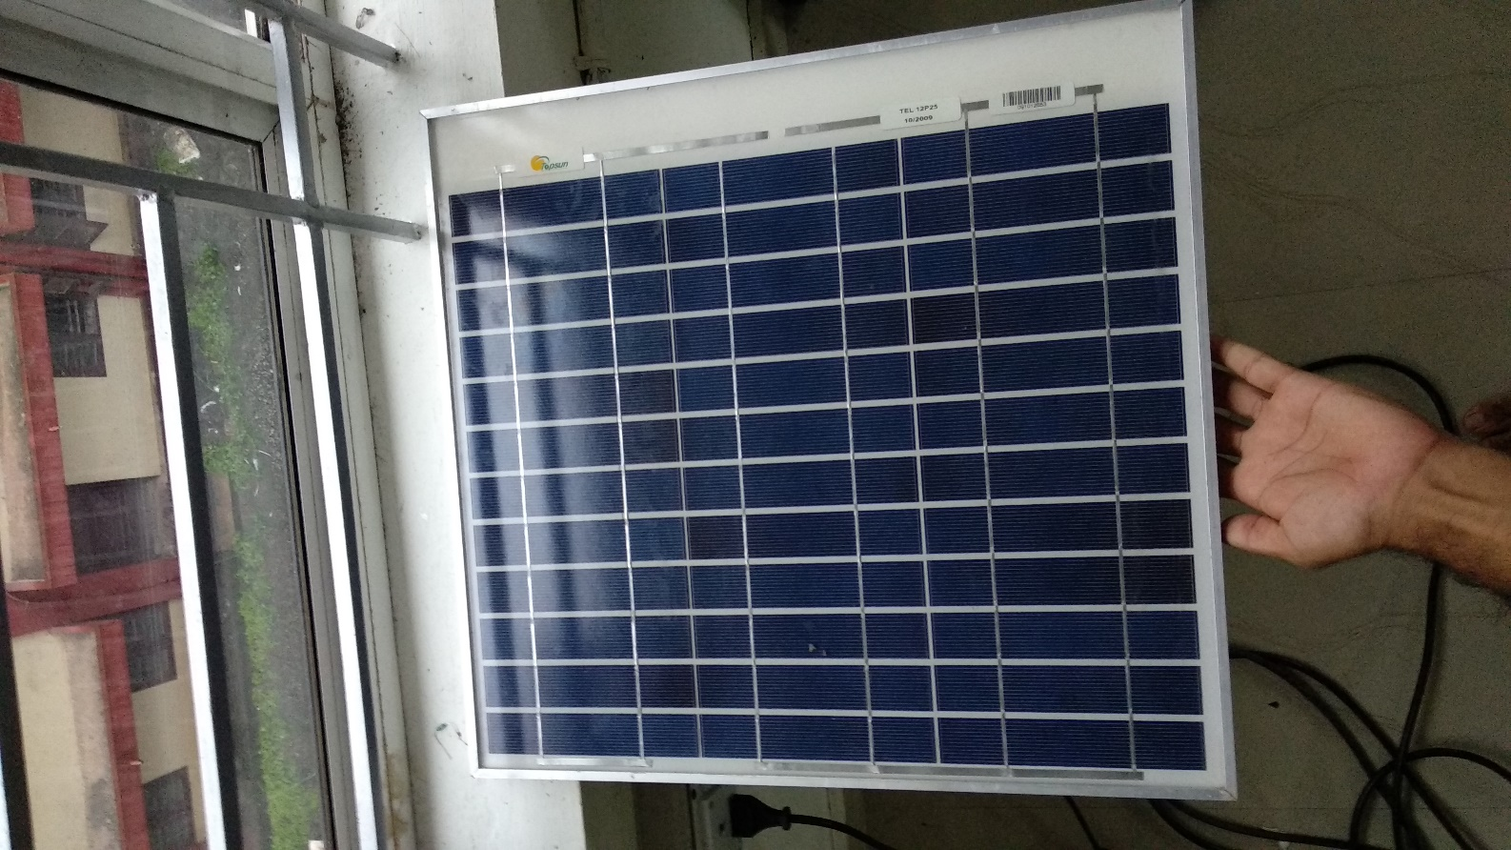
Solar Panel
Poly crystalline Cells 40W
Vmax – 18V
Voc – 22V
imax– 1.5A
Isc- 1.6A

Slide 25
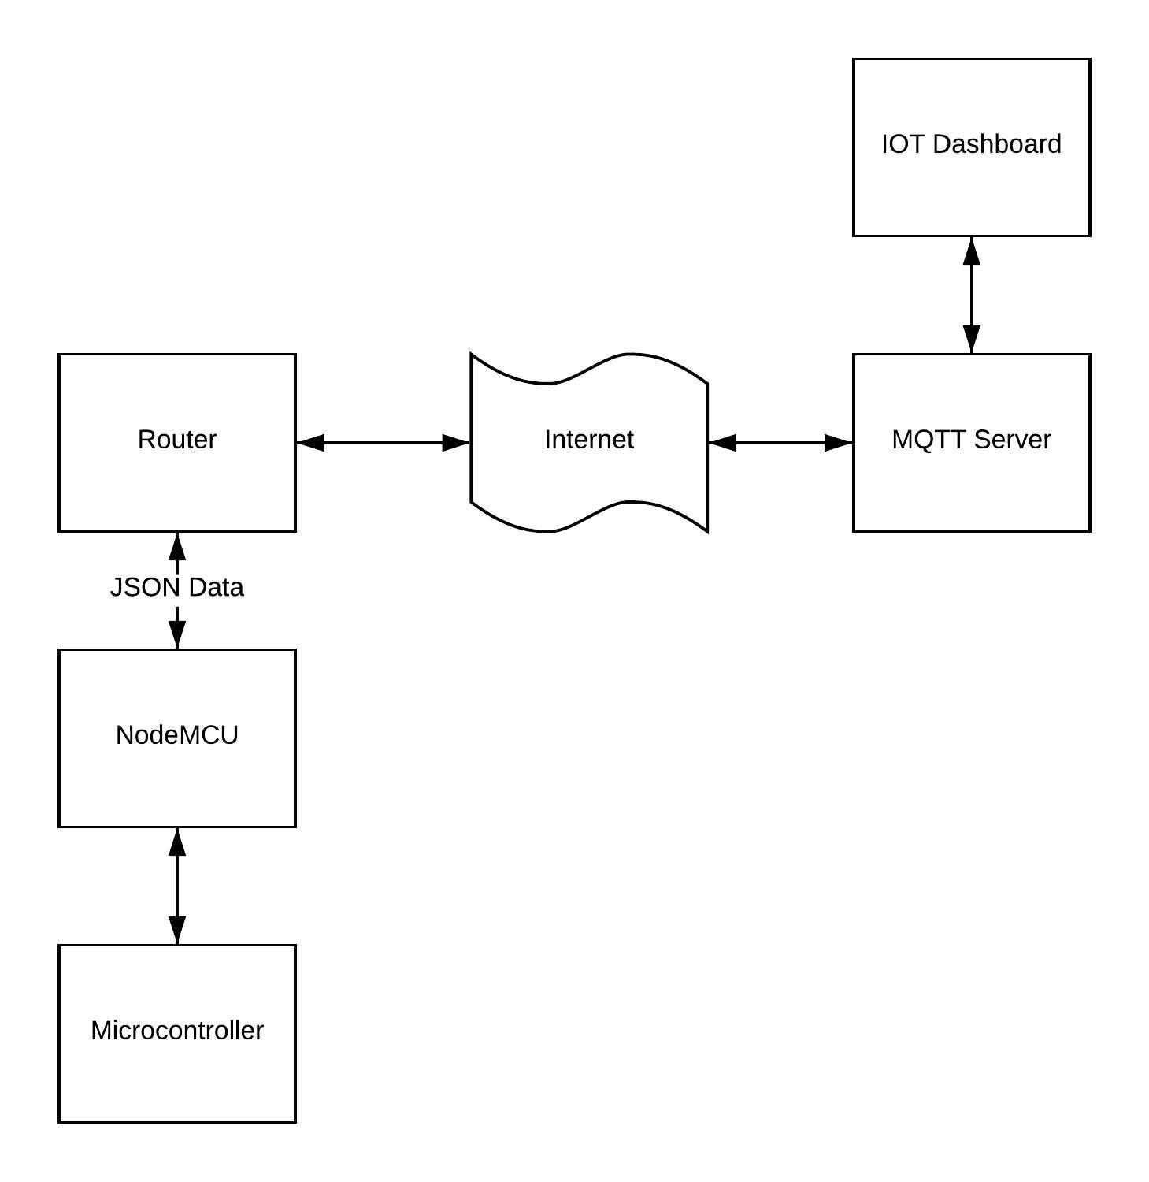
SOFTWARE BLOCK DIAGRAM

Slide 26
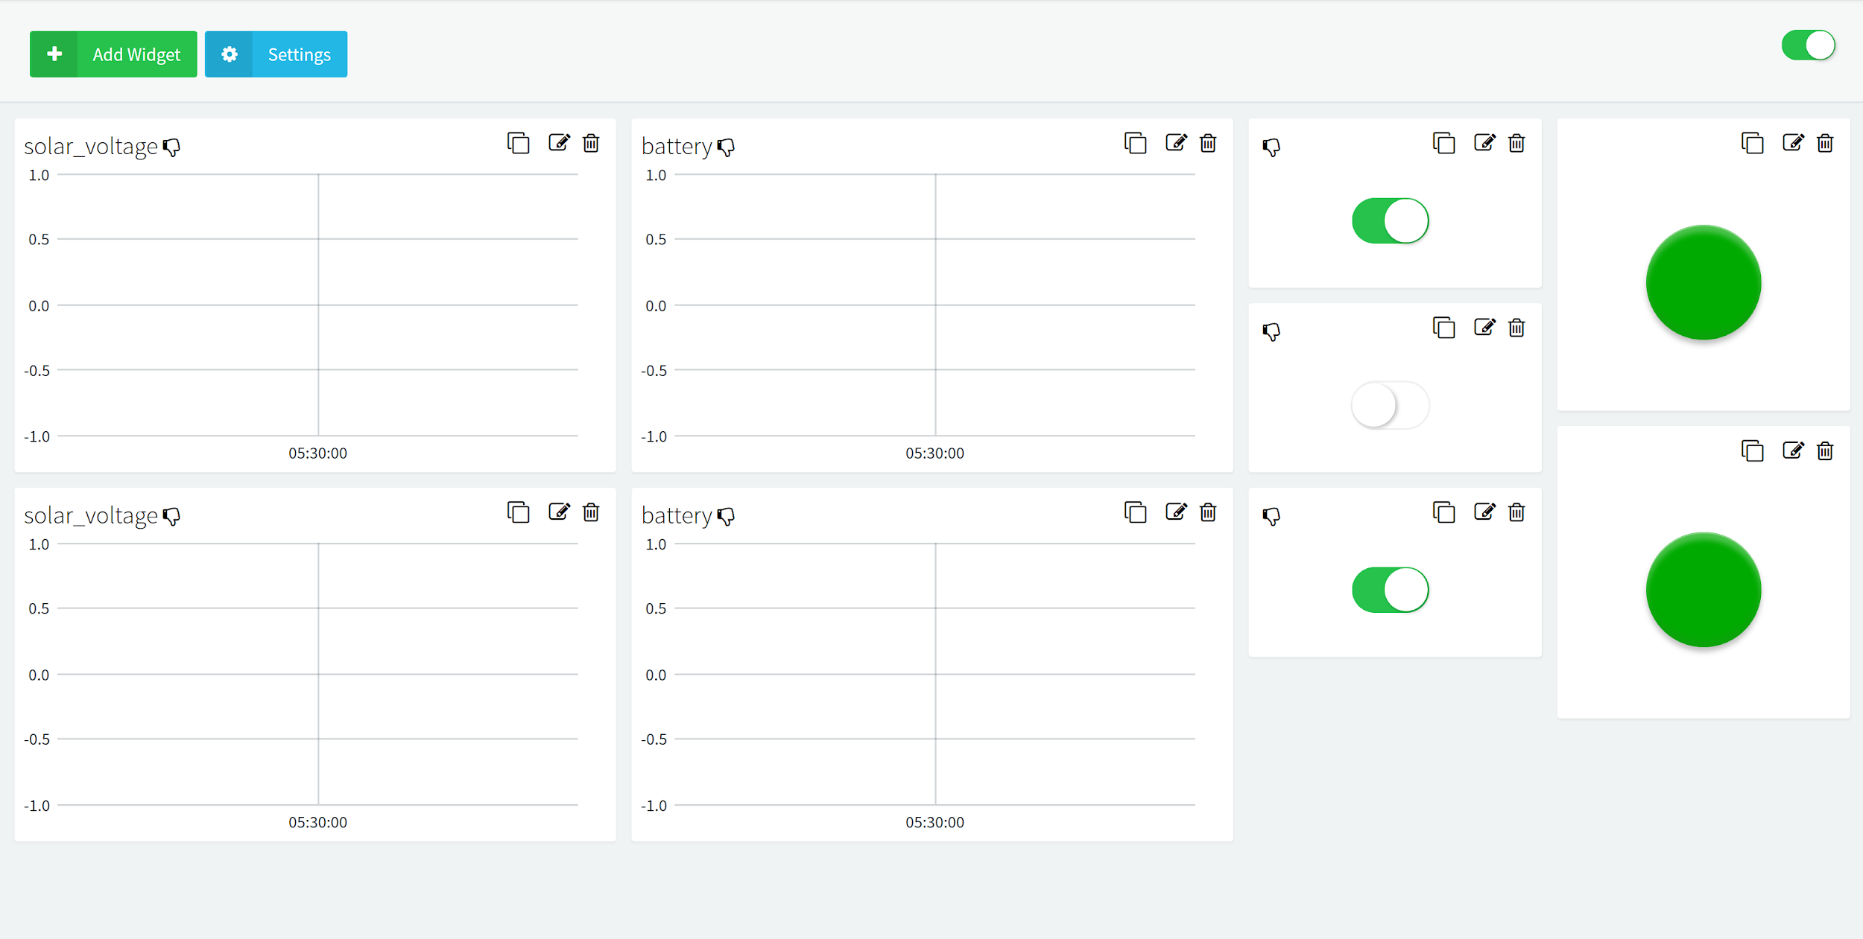
IOT DASHBOARD

Slide 27

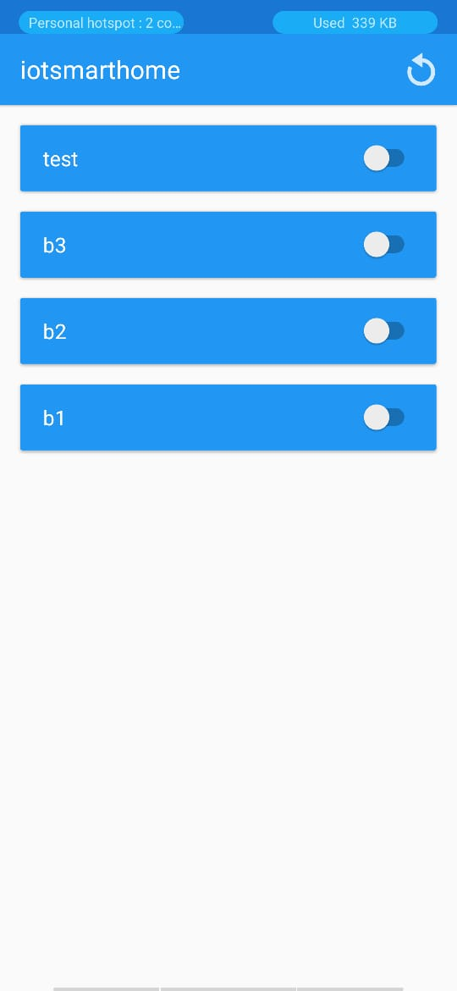
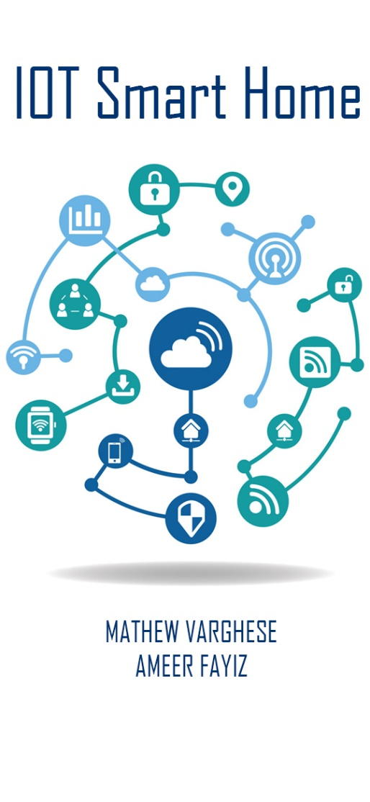
Mobile App

Slide 28
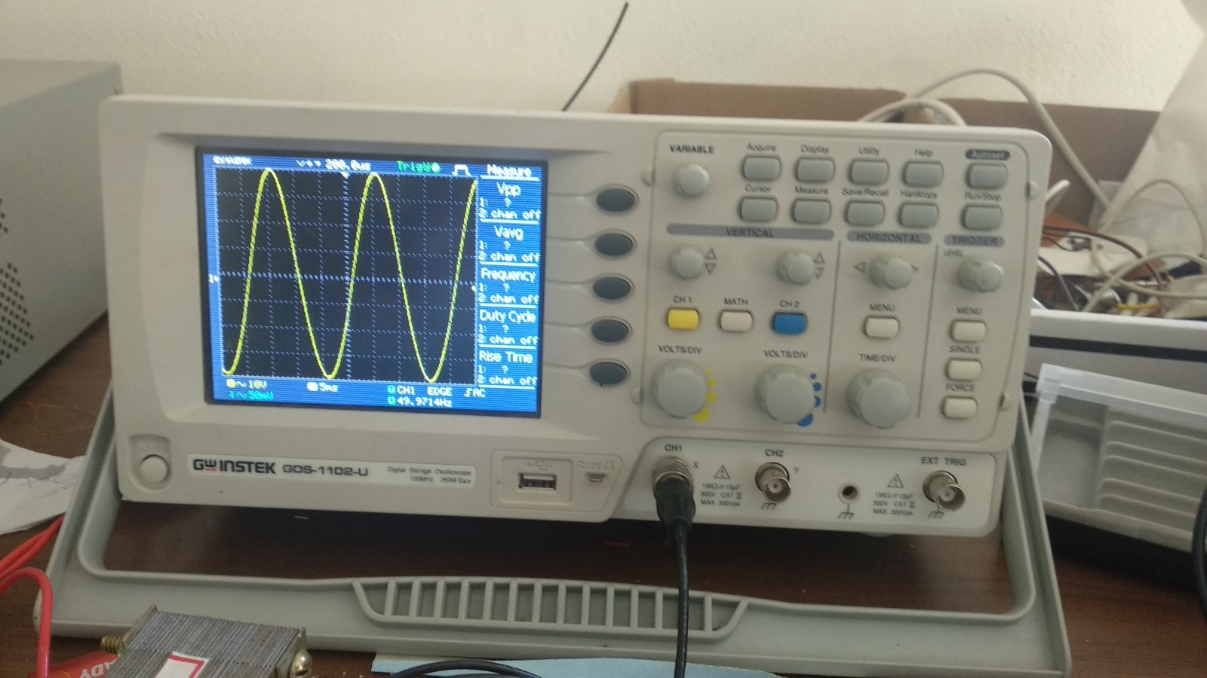
RESULT

Slide 29
ADVANTAGES
All components are easily available in local market except PLC
Telemetry and control of home appliances possible
Sinewave inverter increases efficiency of motors compared to square wave inverters
Each PLC device is plug and play
The code and hardware is available under open source GitHub repos(made by us)
Well documented code

Slide 30
DISADVANTAGES
No short circuit and overvoltage protection for the inverter( can be easily added to the existing project)
Practically, PLC communication is possible only in low speeds (100bps) till 200 meters without expensive transceivers. Wire may have more length in large houses
PLC is sensitive to noise in the AC system when connected to grid
Node MCU consumes high power

Slide 31
CHALLENGES FACED
The Arduino resets randomly when switching on the inverter. This was due to SPWM interference due to the PCB trace and another PCB was designed.
Getting the components for rated current(inductors)
Getting the FSK based PLC communication IC
Finding people working on the field of PLC
Overriding atmega 328p bootloader to enable 64KHz PWM signal
MPPT circuit was hard to design due to the continuous variation of dutycycle needed in the atmega328p register as voltage and current varies

Slide 32
FUTURE SCOPE
The whole project is opensource implying that further development can be coordinated via git system which allows version control and issue tracking.
A blockchain based energy trading can be implemented so that a secure and transparent energy marketplace can be created.
functionalities like short circuit protection, over voltage protection etc can be added

Slide 33
REFERENCES
Salman Salman, Xin Al, Zhouyang WU (2018) Design of a P-&-O algorithm based MPPT charge controller for a stand-alone 200W PV system
Akarte, Vivek & Punse, Nitin & Dhanorkar, Ankush. (2014). Power Line Communication Systems.
Rayyan Azam Khan , Liaquat Ali Khan , Farzan Majeed Noori , Zareena Kausar , and Aaqib Majeed(2016) Design and Simulation of a Sine Wave Inverter with PID Control for Nonlinear Load Applications ISSN 2351-8014 Vol. 26 No. 2 Sep. 2016
Kirti P.Shinde (2017) a low-cost home automation system based on power-line communication links ISSN: 2320-2882

Slide 34
Thank you

